Slide 1


From Data to Dollars: Unleashing the Power of Travel Insurance Predictive Analytics
Classification Model classifying possible customers for Travel Insurance

Slide 2
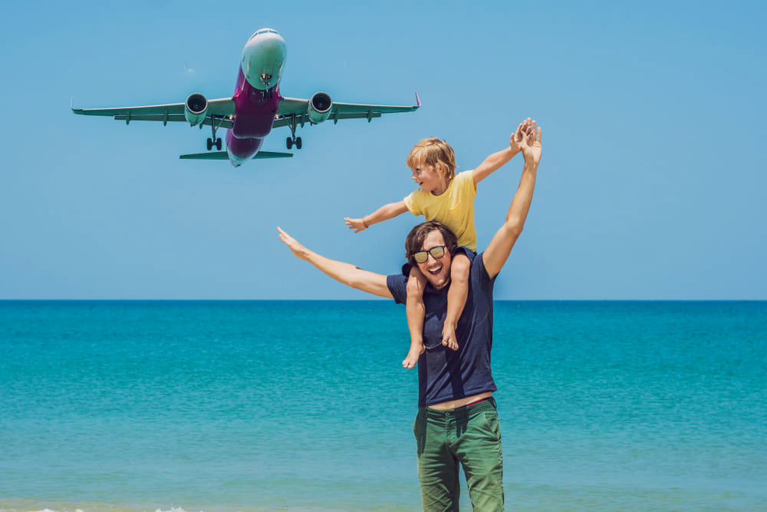
AGENDA TOPICS
Who are we?
Goal
Analysis
Predictive system
Conclusion
Notes:
We are the DNL consulting Firm, and we would like to showcase the project we have undertook on behalf of World Travel Insurnases , in order to develop a Classification model that will skyrocket the insurance company’s revenue.

Slide 3

1. Who we are?
DNL Consulting Co.
Dimitrios Thymioudis, Data Scientist
Nikolaos Christoforou, Data Scientist
Leonidas Bourikas, Data Scientist

Slide 4

2. Goal
World Travel Insurances, Ltd
A Tour & Travels Company offering a new travel insurance package to their customers. They want us to identify which customers would be interested in purchasing the package based on their database history.
DNL Consulting Co.
Prediction of the customers interested to buy the new travel insurance package.

Slide 5

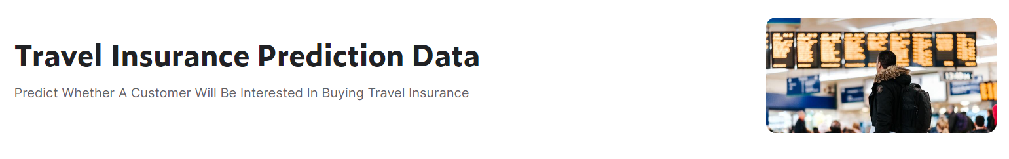

3. Analysis (1/3) - Data Source
DataSource
Open data from https://www.kaggle.com/datasets/tejashvi14/travel-insurance-prediction-data

Slide 6
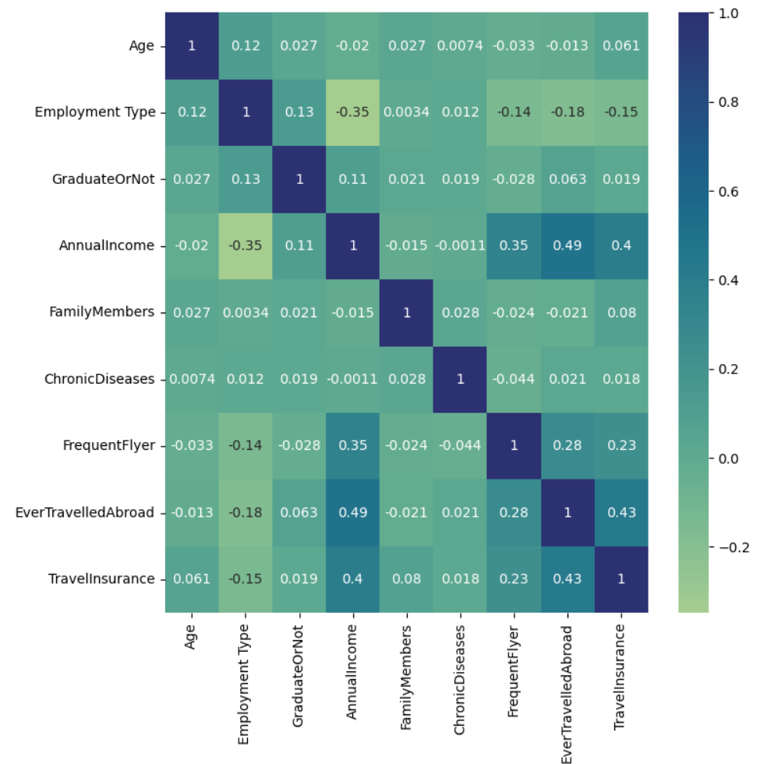

3. Analysis (2/3) - Feature Correlations
Insights:
Not significant Correlations between the data features.

Slide 7
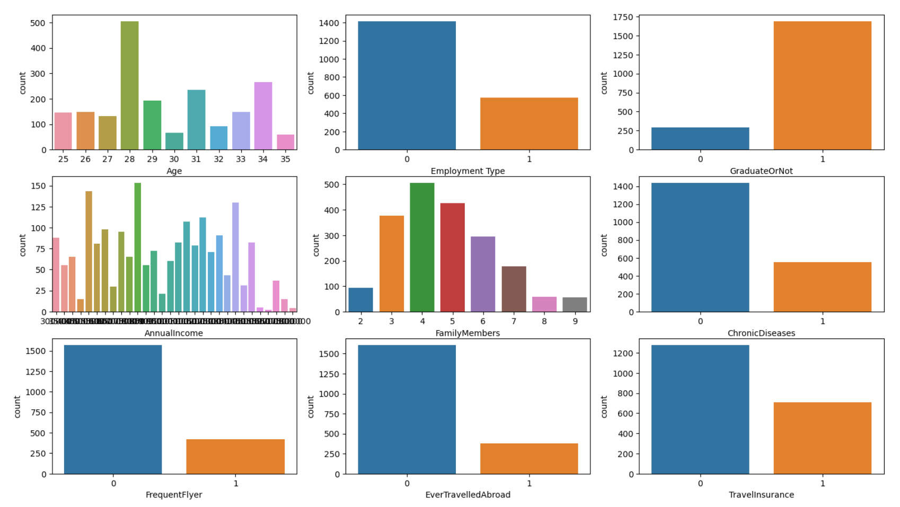
3. Analysis (3/3) - Feature distributions
Insights:
Except of Age, Family Members, and Annual Income, the features are [0,1].
Annual Income and Family Members have normalized distribution.
Most cases are not choosing Travel Insurance (~50%)

Slide 8
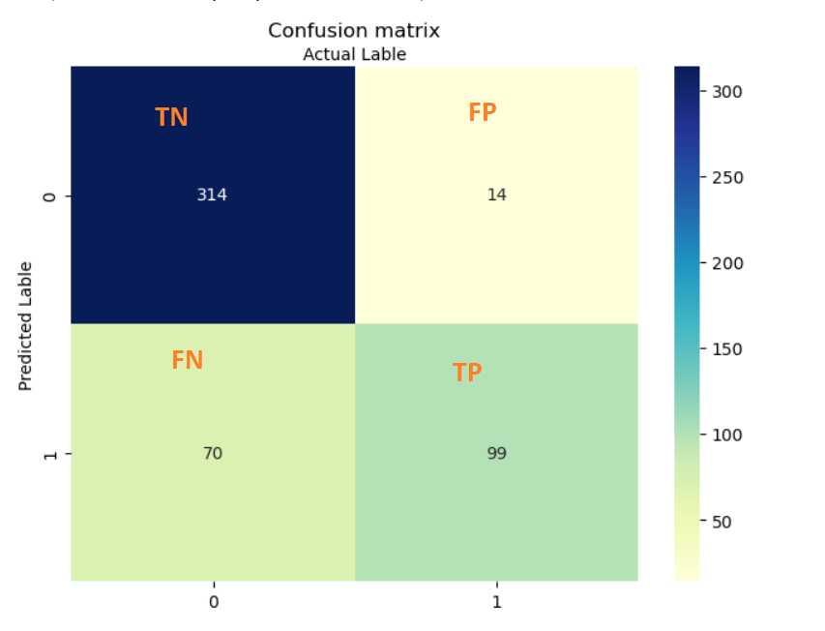
4. Predictive System
Predicted Model:
Supervised Learning: Random Forest Classification Model
Training with the given data according to a client base provided by Insurance Company.
precision recall f1-score support
0 0.82 0.96 0.88 328
1 0.88 0.59 0.70 169
accuracy 0.83 497
macro avg 0.85 0.77 0.79 497
weighted avg 0.84 0.83 0.82 497
True Positive: People correctly insured.
True Negative* : People correctly excluded by the model.
False Positive** : People insured incorrectly.
False Negative: People excluded incorrectly.
*TN = means that we don't spend money on people that may be liabilities (people that may introduce damage to business are correctly excluded)
**FP = means that our makes very few mistakes, on granting insurance on those that constitute liabilities. Than means with this model very few money goes to waste.
Notes:
TN = means that we don't spend money on people that may be liabilities (που δεν πρέπει να ασφαλιστούν γιατί μπορεί να φέρουν ζημιά)
FP = means that our makes very few mistakes, on granting insurance on those that constitute liabilities. Than mean with this model very few money goes to waste.

Slide 9

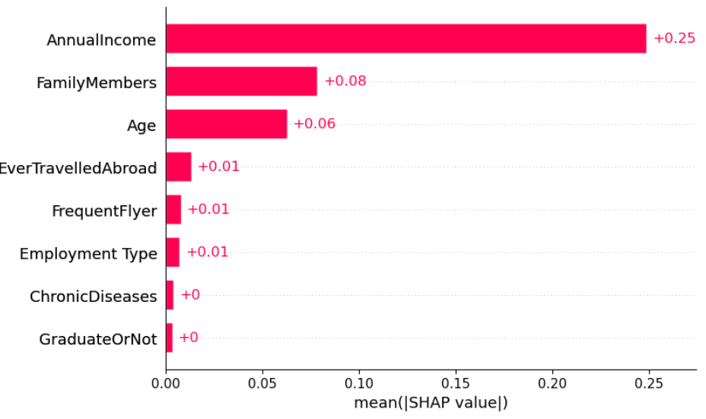
4. Conclusion
Factors that affect the result mostly:
We conclude:
Low false positive = Low money loss for the Company
High True Negative = people that may introduce damage to business are correctly excluded
People most likely to buy travel insurance are those with higher income

